Slide 1
Chapter 2. Introducing the Database. Database systems. Why database design is important?

Slide 2
Outline
1. Introducing the Database.
2. Database systems.
3. Why database design is important?

Slide 3
What is Database
“A collection of data arranged for ease and speed of search and retrieval.”
‒ American Heritage Science Dictionary
• “A structured set of data held in computer storage”
‒ Oxford English Dictionary
• “One or more large structured sets of persistent data, usually associated with software to update and query the data”
‒ Free On-Line Dictionary of Computing

Slide 4
Why we study database?
Databases are important for computing
‒ Many computing applications deal with large amounts of information
‒ Database systems give a set of tools for storing, searching and managing this information
• Databases are a ‘core topic’ in computer science and IT
• Basic concepts and skills with database systems are part of the skill set you will be assumed to have as a CS and IT graduate

Slide 5
Databases are (virtually) everywhere!
• Library catalogues
• Medical records
• Bank accounts
• Telephone directories
• Train timetables
• Airline bookings
• Credit card details
• Student records
• Customer histories
• Stock market prices
• and many more…
• Stock market data
• Personnel systems
• Product catalogues

Slide 6
Only for IT jobs?
“Understanding relational databases is fundamental”
Director of Student Recruitment and Admissions at a UK University
• Not just for I.T. people!
• Useful for many management and administrative jobs

Slide 7
The early days...
Applications store (& persist) their data in files
Each file has its own format
Program has to know format
Any other program using file has to know format

Slide 8
An example
From the Manga Guide to Databases
• The Kingdom of Kod exports apples
• Price is 100G per container of apples
• Three separate departments:
‒ Merchandise ‒ Overseas Business ‒ Export

Slide 9
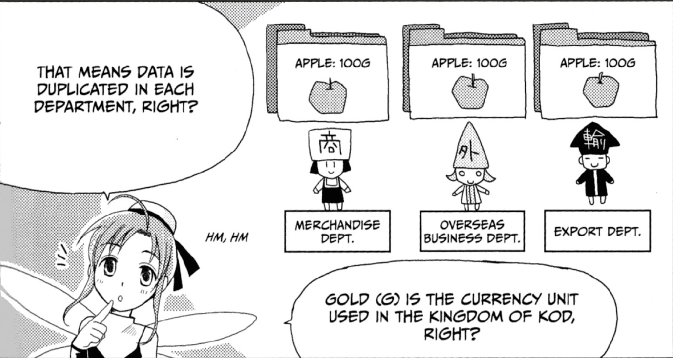
Multiple copies of some data

Slide 10

Can lead to errors...

Slide 11
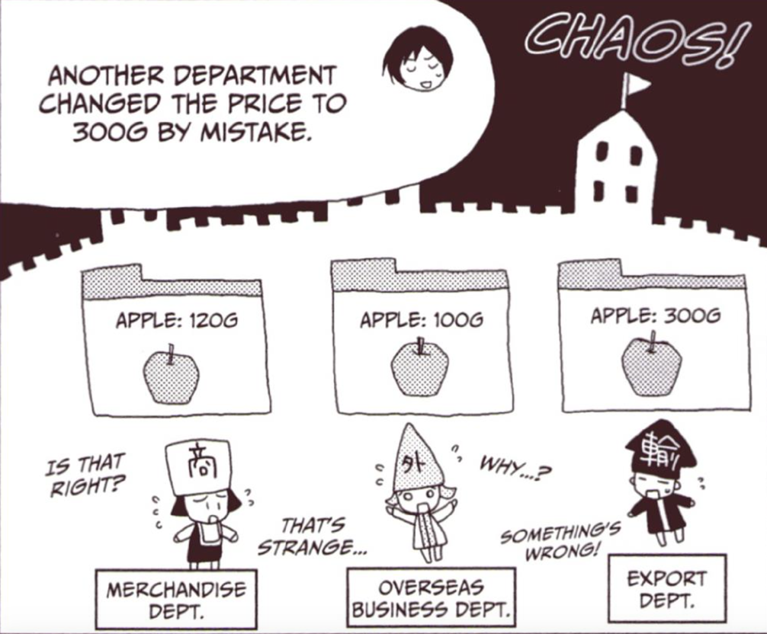
Mistakes happen
Overseas business department didn’t get the message and ...

Slide 12
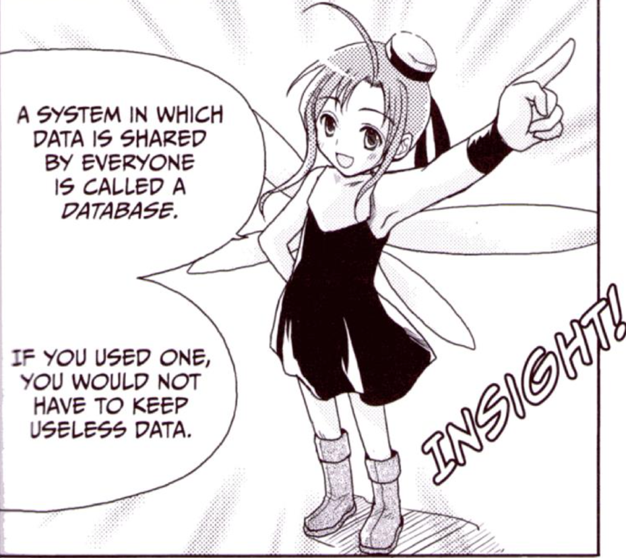
Redundant Data
Storing the same data several times in different places (redundancy) is error-prone!
Notes:
Избыточные данные

Slide 13
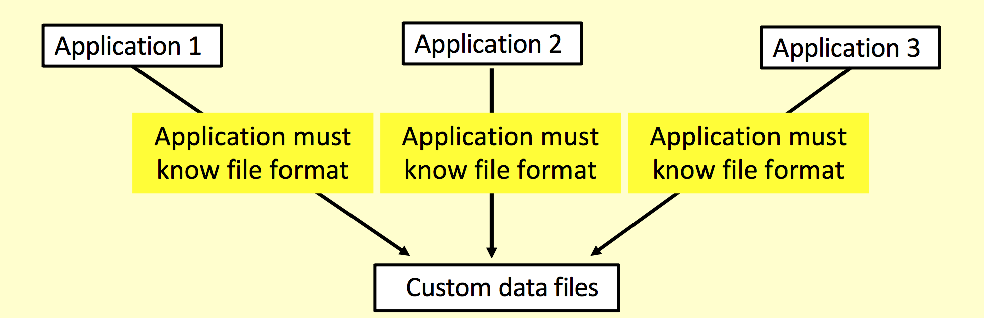
More problems...
There are still problems, for example:
‒ Concurrency (multiple simultaneous changes?)
‒ Security (everyone can see everything?) ‒ Additions or changes to data format? ‒ And others, as we will see
Notes:
Совпадение
Безопасность
Дополнение
файлы пользовательских данных

Slide 14
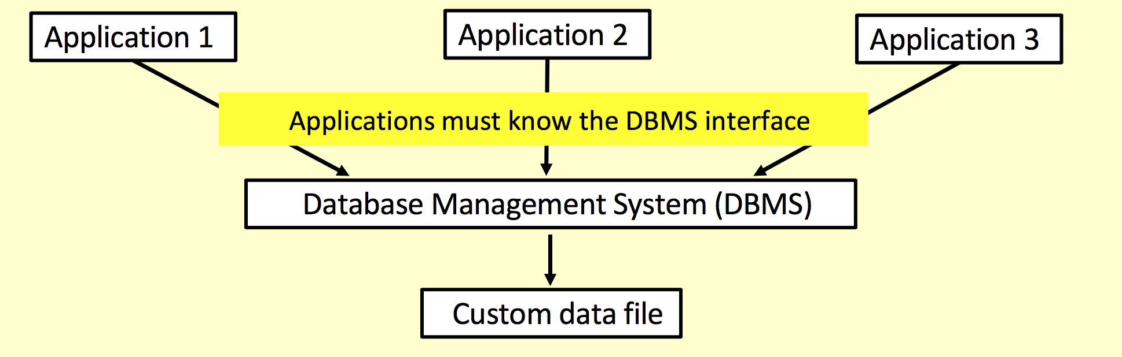
Put something in the middle...
A program in the middle can coordinate access
‒ Preventing simultaneous access problems ‒ Could provide extra integrity and security checks
Notes:
Предотвращение одновременных проблем доступа
Может обеспечить дополнительные проверки целостности и безопасности

Slide 15
Early databases
Early databases were organised by the developer
‒ New functions specifically created, not reusable ‒ Adding new queries was complicated ‒ No standards
– database specific
‒ Data duplication and data dependencies ‒ Did not aid security, recovery, concurrency etc

Slide 16
Relational Databases
1970: E. F. Codd introduced the relational model
‒ “A Relational Model for Large Shared Databanks”
• Information stored as records in relations (tables) ‒ Sound mathematical basis
• Model covers data:
‒ Structure
‒ Integrity ‒ Manipulation
• (Other database models exist, many are old (obsolete?), others are for special purposes)

Slide 17
Advantages of DBMS
Improved data sharing
Improved data security
Better data integration
Minimized data inconsistency
Improved data access
Notes:
несоответствие данных

Slide 18
Disadvantages
Increased costs
Management complexity
Vendor dependence

Slide 19
ANSI / SPARC Architecture
DBs are shared resources and different users may require different views of data held in them
• In 1975 a framework for DBMS was proposed ‒ American National Standards Institute ‒ Standards Planning Requirements Committee
• Three tier/level architecture ‒ Internal level - for systems designers ‒ Conceptual level - for database designers
‒ External level - for database users

Slide 20
Internal Level
Deals with physical storage of data ‒ Structure of records on disk - files, pages, blocks
‒ Indexes and ordering of records
• Used by database system programmers • Internal Schema example:
RECORD EMP LENGTH=44 HEADER: BYTE(5) OFFSET=0
NAME: BYTE(25)
SALARY: FULLWORD OFFSET=30
DEPT: BYTE(10) OFFSET=34

Slide 21
Conceptual Level
Deals with organisation of entire database content
‒ Used by DBAs and application programmers
‒ Abstractions used to remove unnecessary detail
• e.g. Internal level file formats
Database holds metadata (data about data)
‒ E.g. structure information for tables
Conceptual Schema Example:
CREATE TABLE Employee (
Name VARCHAR(25), Salary REAL, Department VARCHAR(10) )

Slide 22
External Level
Provides the view determined by the user
‒ Data may be hidden ‒ Data may be presented in a suitable form ‒ Used by users and applications programmers
External Schema example:
Create View myView as { SELECT Name FROM Employee
}

Slide 23
Example of modern database
• Database Management System (DBMS) ‒ The software that implements a database • Examples:
‒ Oracle
‒ DB2
‒ MySQL
‒ Ingres
‒ PostgreSQL
‒ Microsoft SQL Server
‒ [MS Access?]

Slide 24
DBMS User Facilities
Allow users to:
‒ Store data
‒ Manage change (updates)
‒ Organise data ‒ Retrieve data ‒ Retain privacy (security)
• And they expect it to always work!
‒ i.e. recover from errors, avoid multi-user problems, inform if something goes wrong,...

Slide 25
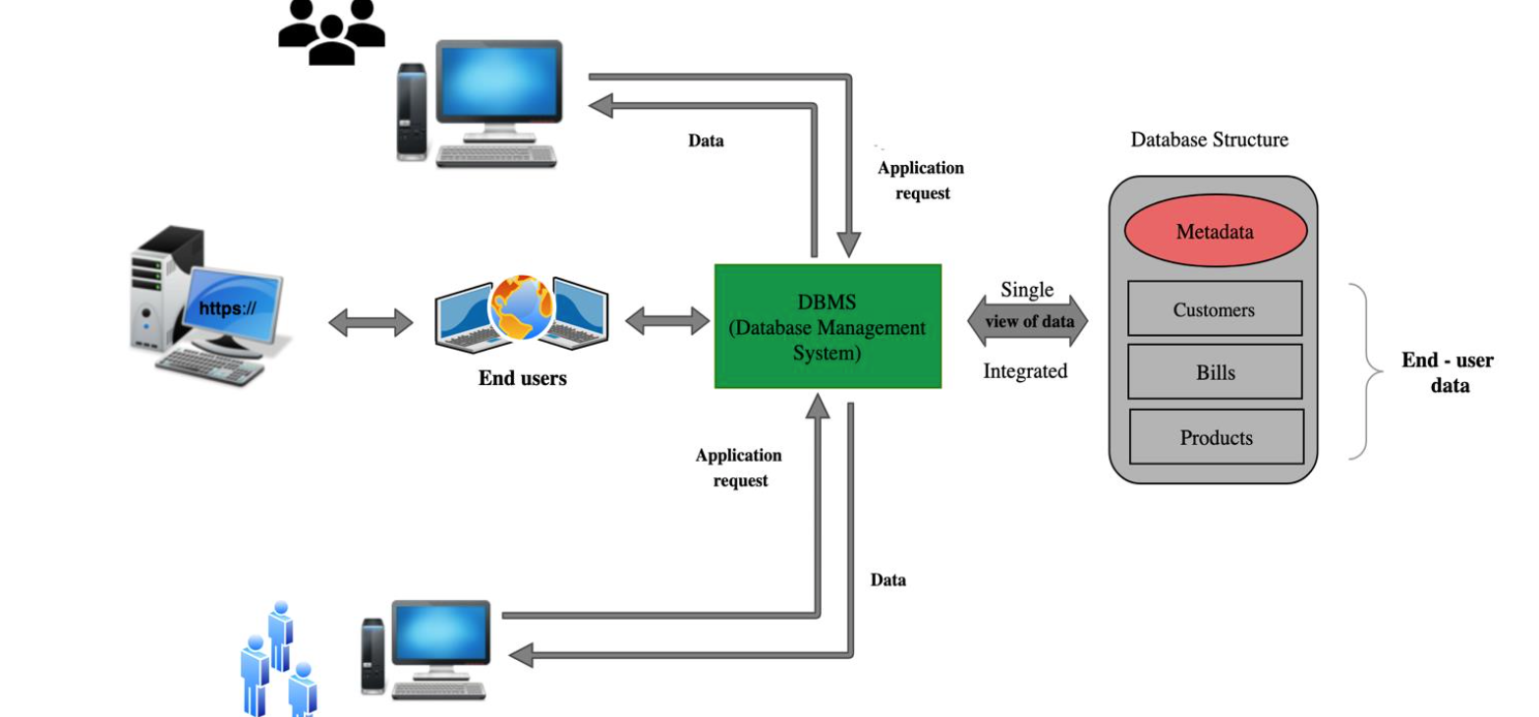
DBMS

Slide 26
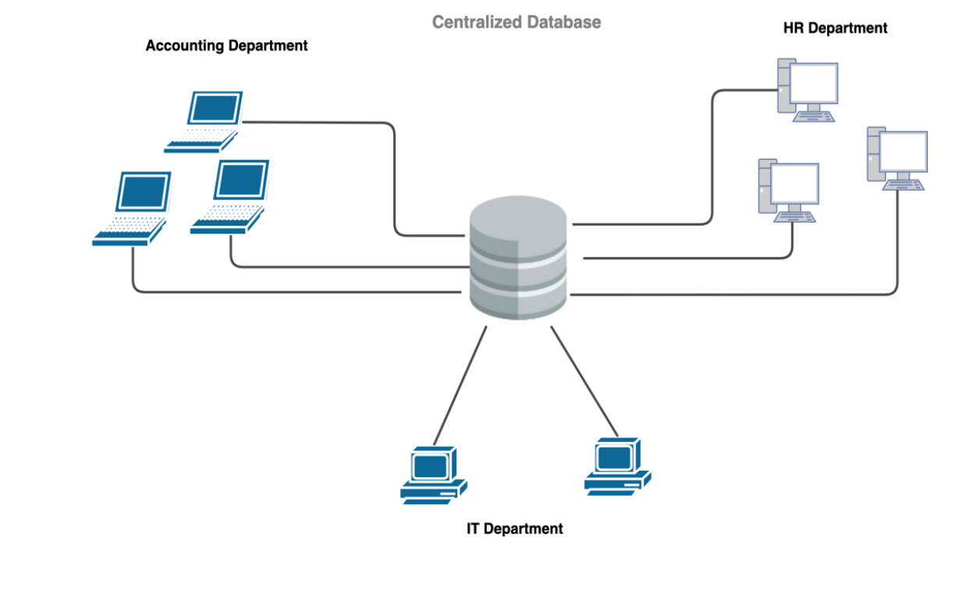
Centralized Database

Slide 27
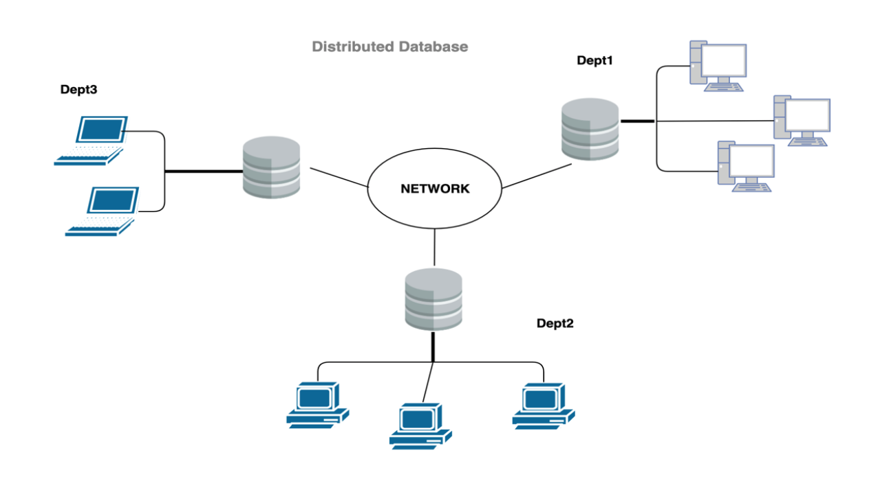
Distributed Database

Slide 28
DBMS Functions
Data transformation and presentation.
Security management (user security & data privacy).
Multiusers access control.
Backup and recovery management.
Data integrity management.
Database access languages and application programming interfaces - Structured Query
Language (SQL) is the de facto query language.

Slide 29
Thank you for your attention!

